Slide 1


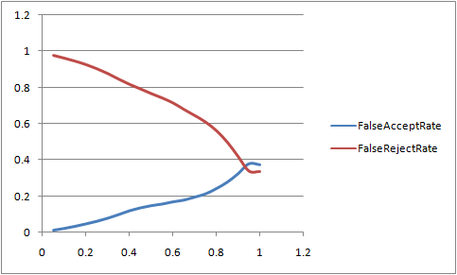
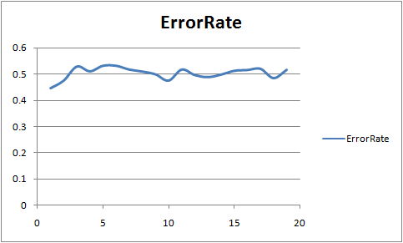
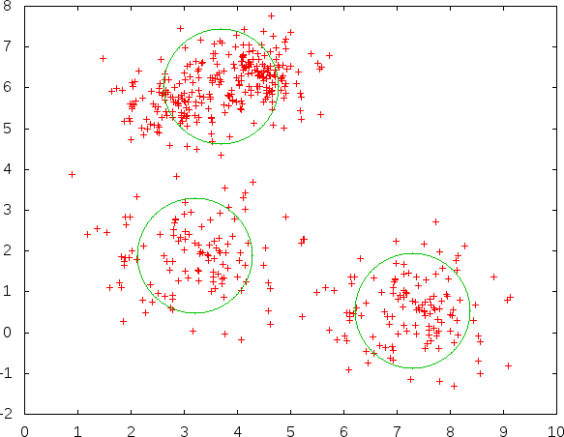
eWatchdog: An Electronic Watchdog for Unobtrusive Emotion Detection based on Usage Analysis
Rayhan Shikder
Email: 0905060.rs@ugrad.cse.buet.ac.bd
Background and proposal
Emotion is, perhaps, the most critical attribute of living beings that is critical to detect and generate artificially. Its detection always remains a classical well-explored problem.
We propose a novel emotion detection system that detects emotion from widely-used electronic devices
  Demanding no additional infrastructure, and
  Exploiting conventionally available usage data.
2.1. Target emotion classes
10 emotion classes including Amusement, happiness, inspiration, surprise, sadness, sympathy, anger, disgust and fear, neutral emotion etc.
2.2 Usage attributes
17 attributes including mouse left click, Mouse right click, Mouse double click, regular key, arrow key, function key, backspace, cursor X distance, cursor Y distance, key down to down time, key up to down time, key down to up time, idle time etc.
3. Working Procedure of Our Study
Emotion Learning System
Emotion Induction System
User
Feature Extraction
Feature-Emotion Mapping
Emotion Classification
Survey Inputs
Usage Data
Features
Figure 1: Our proposed approach for emotion detection
5. Classification of emotion
4. Emotion induction and survey system
We presented various video clips, images, and texts of different emotion classes to the user to induce corresponding emotions and then collected usage attributes from a questionnaire.
Types | False accept rate | False reject rate
10 classes | 0.43 | 0.34
3 classes | 0.25 | 0.17
Table 1: bounded k-means clustering
Figure 3: Percentage of a vs false acceptance and false rejection
Types | False Acceptance Rate
10 classes | 0.76
3 classes | 0.47
Figure 2: Snapshot of the survey system
Table 2: Data from knn
Figure 4: k vs false acceptance in knn
7. References
[1] S. Ioannou, A. Raouzaiou, V. Tzouvaras, T. Mailis, K. Karpouzis and S. Kollias: "Emotion Recognition through Facial Expression Analysis Based on a Neurofuzzy Method," Neural
Networks, vol. 18, pp. 423-435, 2005.
[2] S.G. Kong, J. Heo, B. Abidi, J. Paik and M. Abidi: "Recent advances in visual and infrared face recognition—a review" Computer Vision and Image Understanding, vol. 97, no. 1,
pp. 103-135, Jan. 2005.
[3] H. Gunes and M. Pantic, & ldquo, “Dimensional Emotion Prediction from Spontaneous Head Gestures for Interaction with Sensitive Artificial Listeners”, Proc. Int',l Conf. Intelligent
Virtual Agents, pp. 371-377, 2010.
[4] A.F.M. Nazmul Haque Nahin, Jawad Mohammad Alam, Hasan Mahmud and Kamrul Hasan: “Identifying emotion by keystroke dynamics and text pattern analysis”, Taylor &
Francis online, March, 2014.
Figure 5: Bounded k-means clustering (the cluster radius is bounded by percentage of mean and standard deviation)
6. Conclusion
We found it difficult to detect user emotion while considering 10 different emotional states. But when we considered 3 class of emotions, we got some improvement.
Department of Computer Science and Engineering (CSE), BUET

